Slide 1
Norms Master
Overview & Details
1st December, 2016

Slide 2
Overview
The Norms Master gives flexibility to the User to define Norms against parameters from the application relevant to be displayed in the Loan Approval Report and Loan Approval Form.
Using the Norms Master allows user to select parameters from across the application. Parameters can be selected using the relevant Source and Field. Source of a parameter can be selected from the following list of drop-down choices –
Profit & Loss Account
Balance Sheet
Ratio
Cash Flow Statement
Account Details
Banking Analysis
CIBIL
RTR
Norms can be created for two levels of filters as per current implementation –
Internal Rating : A norm criteria can be defined with different values for different Internal Ratings.
Product : : A norm criteria can be defined with different values for different Products.
This allows the user to create a Norm differently for different combinations of Internal Ratings & Products. For example, a customer with an Internal Rating of XFL-3 and Product type is P1 can have a different norm as compared to a customer with an Internal Rating of XFL-1 and Product type P2.
The Actual value for the Criteria selected to be matched with the Norms defined can be selected as per Time Period (for Criteria selected from Balance Sheet, Profit & Loss, Ratio & Cash Flow Statement ) –
Last Audited Year Available : This selection enables user to match the relevant value from the Last Audited year with the ranges being defined as categories.
Provisional Preferred : This selection enables user to match the relevant value in the order Latest Available Provisional > Last Audited year with the ranges being defined as categories.
Estimated Preferred : This selection enables user to match the relevant value in the order Estimated > order Latest Available Provisional > Last Audited year with the ranges being defined as categories.
For the other type of Parameters, the Time Period is ‘Not Applicable’.
Value type : For numeric type of Parameters there can be two value types – Default (number) and Percentage. If the selected field as a Parameter is a percentage, user must select Percentage for Value Type, otherwise select Default.

Slide 3
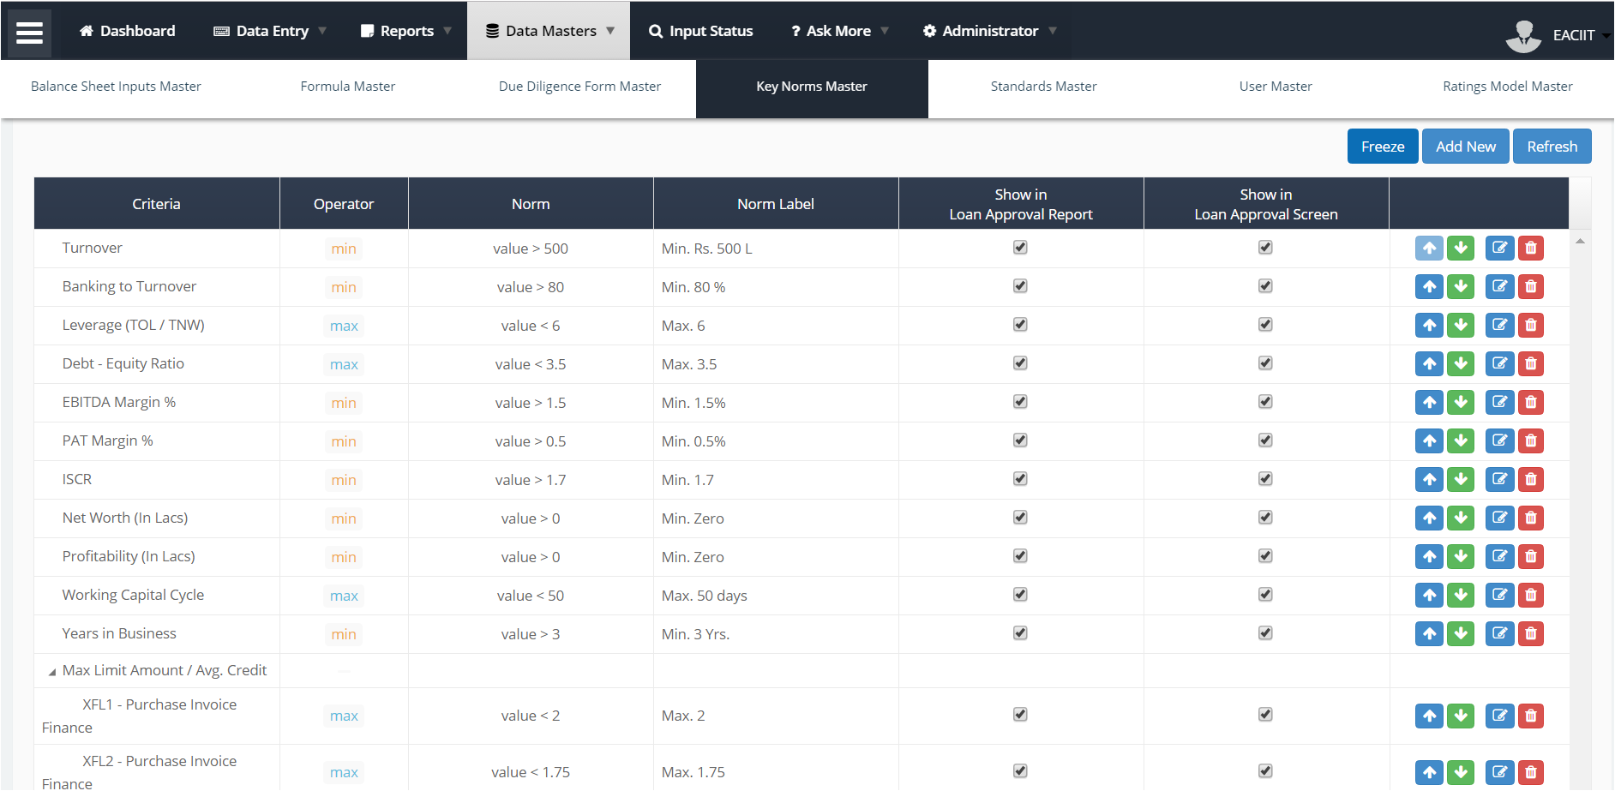
Criteria selected from fields across the application as mentioned in the Overview
Operator defines the condition of the Norm and Norm displays the number which is compared against the Actual Value.
Norm Label displays on the LAR and LAF screen against the Actual value of Criteria
Controls visibility of a Norm on the Loan Approval Report / Screen.
Up / Down buttons to change the positioning of the parameters in the layout.
Edit button (blue) to update the parameter.
Delete button (red) deletes the formula form the Master and Reports.
Norm defined for combinations of Internal Rating and Product illustration.

Slide 4
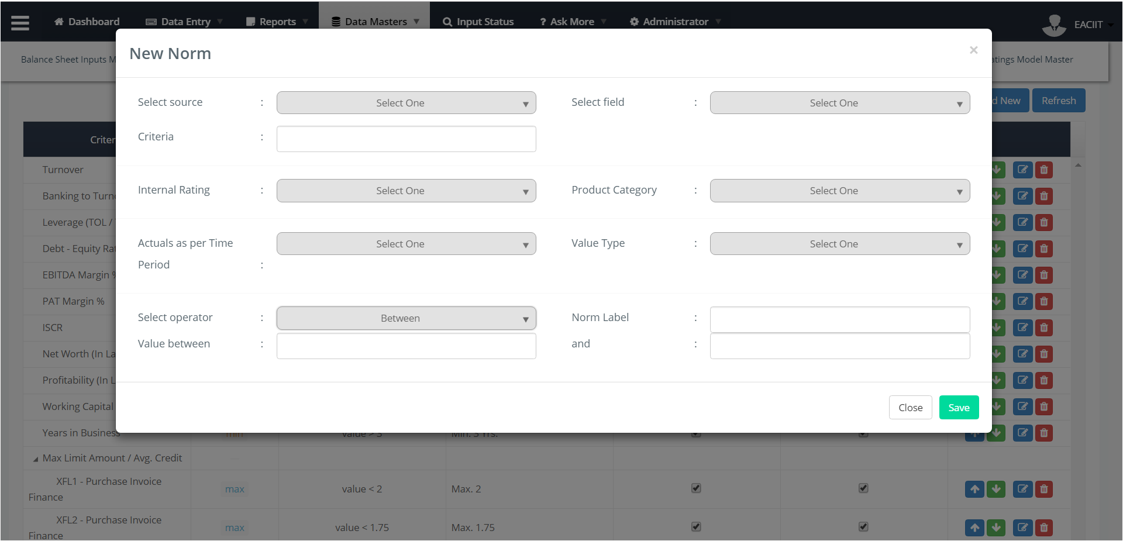
User selects the source to select the Criteria for which the Norm has to be defined.
Dropdown comprises of Profit & Loss, Balance Sheet, Ratio, Cash Flow Statement, Account Details, Banking Analysis, CIBIL and RTR.
This is a mandatory field.
User must select the field to be used as a Criteria.
It is a mandatory field.
User must select the Product applicable for the Norm. Current implementation only one is listed – Purchase Invoice Finance.
User can –
Select a Criteria by choosing the relevant Source and Field.
Rename the Criteria from this box if needed; this field will show the selected Criteria pre-populated.
User can –
Select ‘All’ if the Norm is applicable to all Internal Ratings.
OR select relevant Internal Rating for which the Norm has to e defined.
User must select the type of the Criteria selected.
It can be Default (number) or Percentage.
It is a mandatory field.
User can –
User must select the time period of the Criteria selected. This is applicable only when User has Source selected as Balance Sheet, Profit & Loss, Ratio and Cash Flow Statement.
If Criteria is not from the Sources listed above, default value for this field is ‘Not Applicable’.
It is not a mandatory field
User can select the operator like Min., Max., Greater than and equal to, etc. to define the Norm.
User can add relevant value to define the category.
User can add a label for the Norm that needs to be display on the LAR and LAF.

Slide 5
Data Output
The Norms Master enables user to create a list of Norms to be displayed in –
Loan Approval Report – Key Policy Parameters Check Section.
Loan Approval Form – Key Policy Parameters (Bullet charts to display the Norm vs Actual representation graphically and display a tabular representation of the same in the Detailed Screen)
Add New button – On saving a new Norm added it reflects in the LAR and LAF.
Edit button – On editing a Norm and saving the changes from the pop-up, the changes are reflected in the LAR and LAF.
Changing the position of Norms – Checking and un-checking the check box reflects the changes made in the LAR and LAF.

Slide 6
<End of Norms Master Specs>

